Slide 1

Application of Shuffled Complex Evolution Optimization Approach (SCE-UA) to a global terrestrial ecosystem model (TEM)
Speaker: Sirui Wang
Class: EAPS 657 Spring

Slide 2

Background
Global climatic warming has been pronounced in recent decades, and it could influence the global carbon cycle. Thus, quantitative understanding of carbon dynamics is essential.
Terrestrial ecosystem model is a great tool for studying carbon cycling. The critical step in modeling is the process of calibration, which determines proper parameters used in model.
A global optimization method known as the SCE-UA method (abbreviation for shuffled complex evolution method developed at The University of Arizona), was designed for model calibration by Dr. Qingyun Duan.

Slide 3
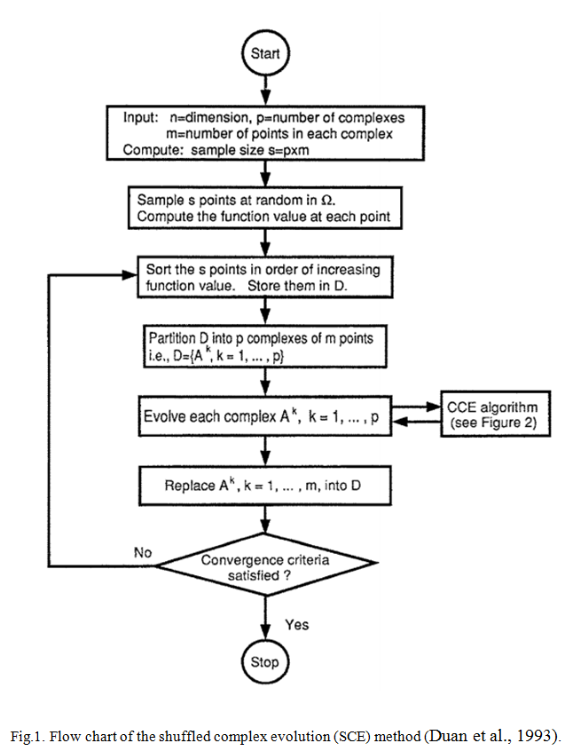
Method
The goal of calibration is to find those values for the model parameters that minimize objective function which represents the fitting between the simulated and observed outputs.
1. A brief procedure of SCE-UA method
(1) Initialize: determine the sample size
(2) Generate sample: sample s points randomly in the feasible parameter space and compute the objective function at each point. In the absence of prior information, use a uniform sampling distribution.
(3) Rank points: sort the s points in order of increasing function value. Store them in an array D.
(4) Partition into complexes: partition D into p complexes, each containing m points.
(5) Evolve each complex--evolve each complex according to the competitive complex evolution (CCE) algorithm (the detailed algorithm is based on Nelder and Mead, 1965)
(6) Shuffle complexes--combine the points in the evolved complexes into a single sample population D; sort D in order of increasing function value.
(7) Check convergence

Slide 4
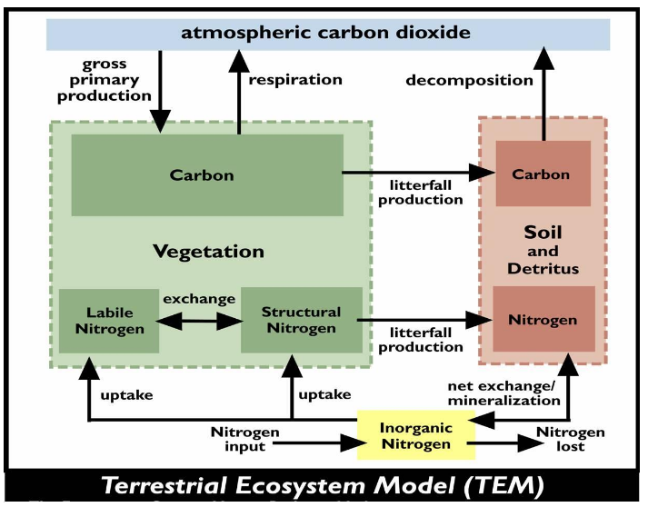
2. A general introduction to terrestrial ecosystem model (TEM)
TEM is a highly aggregated large-scale biogeochemical model that estimates the dynamics of carbon and nitrogen fluxes and pool sizes of plants and soils.
Fig.2. Structural schemes for terrestrial ecosystem model (Raich et al., 1991; Zhuang et al., 2003).

Slide 5

Spatially referenced information on climate, elevation, soils and vegetation, as well as the gridded monthly climate data of air temperature , precipitation and cloudiness were used to drive the model, and then the model will output carbon fluxes such as GPP, NPP and NEP.
In the model, the region were divided into several vegetation types. A large number of vegetation-specific parameters are need to be estimated.
Fig.3. Forcing data, inputs and outputs for terrestrial ecosystem model (Raich et al., 1991; Zhuang et al., 2003).

Slide 6
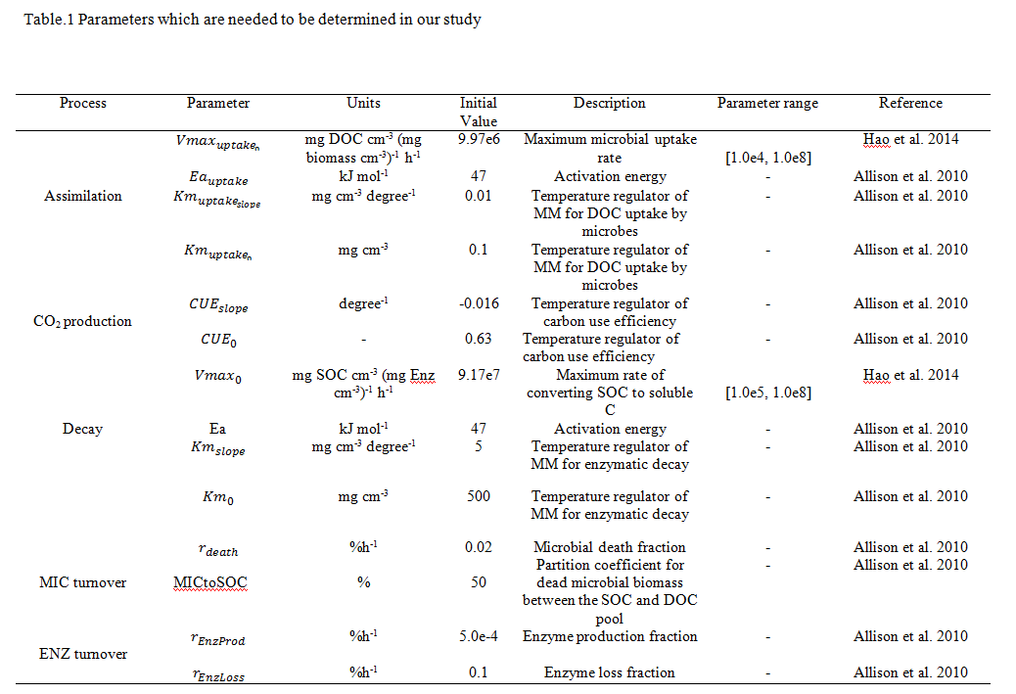
Application
Model calibration: determine some vegetation-specific parameters using SCE-UA method
We parameterized TEM for six representative ecosystem types in northern high latitudes. The observed monthly net ecosystem production (NEP, gCm⁻² mon⁻¹) data derived from Ameriflux network were compared with model output.
The desired parameters should minimize the difference between the observed and simulated NEP. The objective function of the minimization is:
k is the number of data pairs for comparison. An ensemble of 100 independent optimization runs were performed based on prior ranges from the literature (table 1), each using different random number seeds to determine the successive evolution steps.

Slide 7
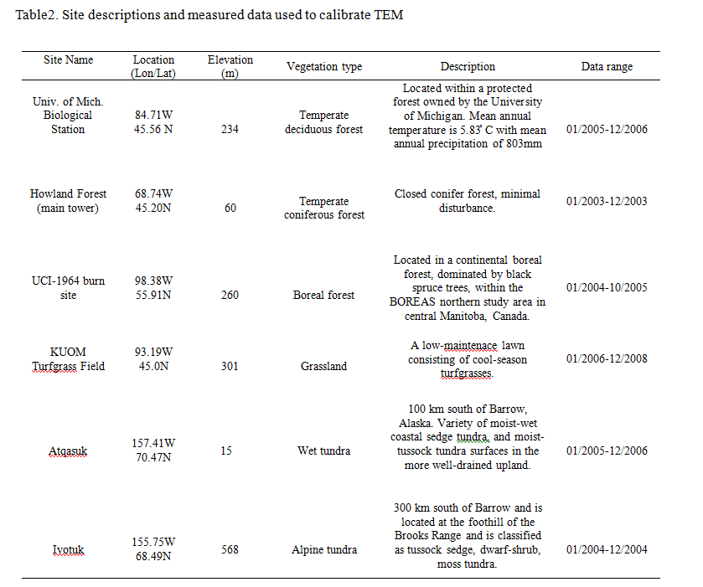

Slide 8
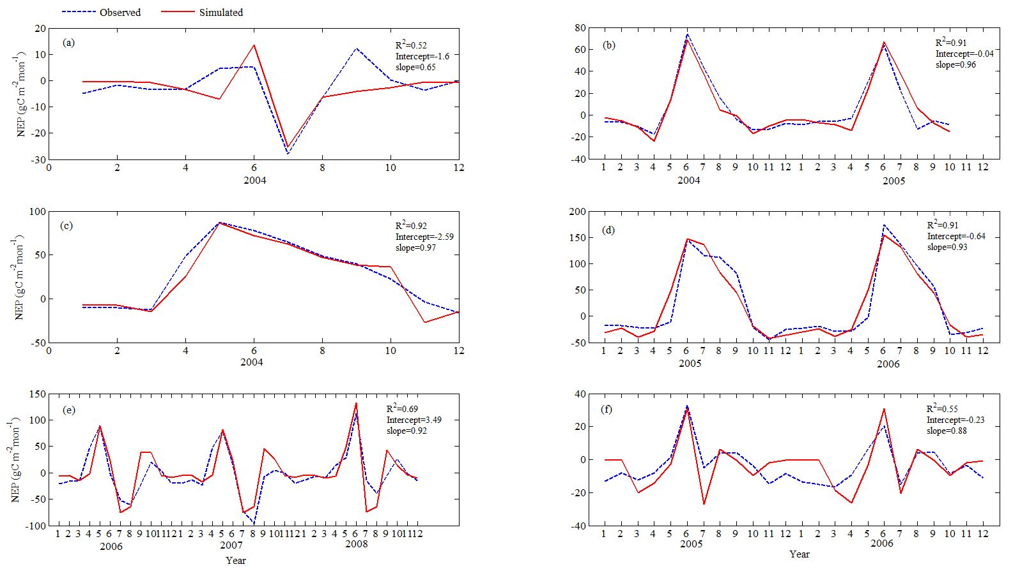
Fig.4. Results for calibration: comparisons between observed and simulated NEP (gC m⁻²mon⁻¹) using the parameters determined by SCE-UA method: (a) at Ivotuk (alpine tundra), (b) UCI-1964 burn site (boreal forest), (c) Howland Forest (main tower) (temperate coniferous forest), (d) Univ. of Mich. Biological Station (Temperate deciduous forest), (e) KUOM Turfgrass Field (Grassland), (f) Atqasuk (Wet tundra).

Slide 9
Summary
The great properties of SCE-UA method (Duan et al., 1994):
Ability to avoid being trapped by small pits and bumps on the objective function surface;
Robustness in the presence of differing parameter sensitivities and parameter interdependence;
Non-reliance on the availability of an explicit expression for the objective function or the derivatives;
Capability of handling high-parameter dimensionality.
It is a robust, effective, and efficient method for model calibration!

Slide 10
Thank you!

